Slide 1
Search technique
Unit 3

Slide 2
Outline
Searching
Uninformed Search Techniques
Breadth First Search
Uniform Cost Search
Depth First Search
Backtracking Search
Depth Limited Search
Iterative Deepening Depth First Search
Bidirectional Search
Search Strategy Comparison
Informed Search Techniques
Best First Searching
Greedy Search
A* Search
Local Search Algorithm & Optimization
Iterative Improvement Algorithm
Hill Climbing Search
Simulated Annealing Search
Local Beam Search
Genetic Algorithm
Adversarial Search Techniques
Mini-max Procedure
Alpha Beta Procedure

Slide 3
Searching
Step in Problem Solving
Searching is Performed through the State Space
Searching accomplished by constructing a search tree
A
B
C
D
E
F
H
G

Slide 4
Searching: Steps
Check whether the current state is the goal state or not
Expand the current state to generate the new sets of states
Choose one of the new states generated for search which entire depend on the selected search strategy
Repeat the above steps until the goal state is reached or there are no more states to be expanded

Slide 5
Searching: Criteria to Measure Performance
Completeness: Ability to find the solution if the solution exists
Optimality: Ability to find out the highest quality solution among the several solutions
Should maintain the information about the number of steps or the path cost from the current state to the goal state
Time Complexity: Time taken to find out the solution
Space Complexity: Amount of Memory required to perform the searching

Slide 6
Searching: Types
Blind Search or Uninformed Search
Informed Search or Heuristic Search

Slide 7
Searching: Evolution Function
A number to indicate how far we are from the goal
Every move should reduce this number or if not never increase
When this number becomes zero, the problem is solved (there may be some exceptions)

Slide 8
8 Puzzle Games
1 | 2 | 3
8 |  | 4
7 | 6 | 5
2 | 8 | 3
1 | 4
7 | 6 | 5
Its Goal State
Evolution Function = 0
Its Initial State
Evolution Function = -4

Slide 9
Searching: Problem Classification
Ignorable: Intermediate actions can be ignored. Example: Water Jug Problem
Recoverable: The actions can be implemented to go the initial states. Example: 8 Puzzle Games
Irrecoverable: The actions can’t be implemented to reach the previous state. Example: Tic-Tac-Toe
Decomposable: The problem can be broken into similar ones. Example: Bike Racing

Slide 10
Uninformed Search
Search provided with problem definition only and no additional information about the state space
Expansion of current state to new set of states is possible
It can only distinguish between goal state and non-goal state
Less effective compared to Informed search

Slide 11
Breadth First Search
Root node is expanded first
Then all the successors of the root node are expanded
Then their successors are expanded and so on.
Nodes, which are visited first will be expanded first (FIFO)
All the nodes of depth ‘d’ are expanded before expanding any node of depth ‘d+1’
A
B
D
C
G
E
H
F

Slide 12
Breadth First Search: Four Criteria
Completeness
d: depth of the shallowest goal
b: branch factor
This search strategy finds the shallowest goal first
Complete, if the shallowest goal is at some finite depth
Optimality
If the shallowest goal nodes were available, it would already have been reached
Optimal, if the path cost is a non-decreasing function of the path of the node

Slide 13
Breadth First Search: Four Criteria
Time Complexity
For a search tree a branching factor ‘b’ expanding the root yields ‘b’ nodes at the first level.
Expanding ‘b’ nodes at first level yields b² nodes at the second level.
Similarly, expanding the nodes at (d+1)^{th} level yields b^{d} node at d^{th} level
If the goal is in d^{th} level, in the worst case, the goal node would be the last node in the d^{th} level
Hence, We should expand (b^{d}-1) nodes in the d^{th} level (Except the goal node itself which doesn’t need to be expanded)
So, Total number of nodes generated at d^{th} level = b(b^{d}-1) =b^{d+1}-b
Again, Total number of nodes generated = 1+b+b²+…+b^{d+1}-b =O(b^{d+1})=O(b^{d})
Hence, time complexity is O(b^{d+1}) where, b= branching factor and d= level of goal node in the search table

Slide 14
Breadth First Search: Four Criteria
Space Complexity
Same as time complexity
i.e. O(b^{d+1})
Since each node has to be kept in the memory
Disadvantages
Memory Wastage
Irrelevant Operations
Time Intensive
It doesn’t assure the optimal cost solution

Slide 15
Uniform Cost Search
It expands the lowest cost mode on the fringe
The first solution is guaranteed to be the cheapest one because a cheaper one would have expanded earlier and so would have been found first
Required Condition: A to H
ABEH=21, ACH=5, ACFH=7, ADIH=6
A
3
1
B
4
D
C
2
12
2
1
I
F
E
1
8
H
1

Slide 16
Uniform Cost Search
Solution: Required Operation
Expand A→ Yield B, C, D With AB=1, AC=4, AD=3
Expand B→ Yield E with ABE=13 As ABE>AC and ABE>AD
Expand D→ Yield I with ADI=5 As ADI>AC
Expand C→ Yield H and F with ACH=5 and ACF=6
Solution Achieved
If all step costs are equal, it is identical breadth first search
A
3
1
B
4
D
C
2
12
2
1
I
F
E
1
8
H
1

Slide 17
Uniform Cost Search
Disadvantages
Doesn’t care about the number of steps a path has but only about their cost
It might get stuck in an infinite loop if it expands a node that has a zero cost action leading back to same state

Slide 18
Uniform Cost Search: Four Criteria
Completeness
Complete, if the cost of every step is greater than or equal to some small positive constant E
Optimality
The same ensures optimality
Time Complexity
O(b ^{C*/E})
Where C*→ cost of optimal path and E→ small positive constant
This complexity is much greater than that of Breadth first search
Space Complexity
O(b ^{C*/E})

Slide 19
Depth First Search
Expands the nodes at the deepest level of the search tree (LIFO)
When a dead end is reached, the search backup to the next node that still has unexplored successors
A
B
D
C
G
I
E
H
F

Slide 20
Depth First Search: Four Criteria
Completeness
Can get stuck going down the wrong path
It will always continue downwards without backing up
If the path chose get infinitely down, even when shallow solution exists
Not complete
Optimality
The strategy might return a solution path that is longer than the optimal solution, if it starts with an unlucky path
Not optimal

Slide 21
Depth First Search: Four Criteria
Space Complexity
It needs to store a single path from root to a leaf node and the remaining unexpanded sibling nodes for each node in the path
For a search tree of branching factor ‘b’ and maximum tree depth ‘m’, only the storage of b_{m+1} node is required
Hence, Space Complexity= O(b.m+1) = O(bm)
Time Complexity
O(b^{m}), in the worst case, since in the worst case all the b^{m} nodes of the search tree would be generated
Hence, Time Complexity= O(b^{m})

Slide 22
Backtracking Search
It uses still less memory
Only one successor is generated at a time rather than all
Each partially expanded nodes remember which node to expand next
Completeness: Not Complete
Optimality: Not Optimal
Time Complexity= O(b^{m})
Space Complexity= O(m)

Slide 23
Depth Limited Search
Modification of depth first search
Depth first search with predetermined limit ‘l’
After the nodes at the level ‘l’ are explored, the search backtracks without going further deep
Hence, it solves the infinite path problem of the depth first search strategy
Completeness: Complete except at additional source of incompleteness if l>d
Optimality: Optimal except at l>d
Time Complexity=O(b^{l})
Space Complexity=O(bl)

Slide 24
Exercises
A farmer has to cross a river with his Fox, Goose, and Grain. Each trip, his boat can only carry himself and one of his possessions. How can he cross the rivers if an unguarded fox eats the goose and an unguarded goose the grain.
Perform Depth-first-search(DFS)
Perform Breath-First-Search(BFS)
Construct a complete Search Tree.

Slide 25
Exercise
Three missionaries and three cannibals must cross a river using a boat which can carry at most two people, under the constraint that, for both banks and the boat, if there are missionaries present on the bank (or the boat), they cannot be outnumbered by cannibals (if they were, the cannibals would eat the missionaries). The boat cannot cross the river by itself with no people on board.
Perform DFS
Perform BFS
Construct a complete search tree

Slide 26
Iterative Deepening Depth First Search
Finds the best limit by gradually increasing depth limit l first to 0, then to 1, 2 and so on
Combines the benefits of the depth first and breadth first search
The complex part is to choose good depth limit
This strategy addresses the issue of good depth limit by trying all possible depth limits
The process is repeated until goal is found at depth limit ‘d’ which is the depth of shallowest goal
Completeness: as of Breadth First Search i.e. Complete if branching factor is finite
Optimality: as of Breadth First Search i.e. optimal if the path cost is non decreasing function of depth
Time Complexity= O(b^{d})
Space Complexity= O(b^{d})

Slide 27
Bidirectional Search
Performs two simultaneous searches, one forward from initial state and the other backward from the last state
Search stops when the two traversals meet in the middle
Completeness: Complete if both searches are B.F.S. and b is finite
Optimality: Optimal if both searches are B.F.S.
Time Complexity
For B.F.S. is O(b^{d+1})
If B.F. Bidirectional Search is used then the complexity = O(b^{d/2})
Since the forward and backward searches have to go halfway only
Space Complexity= O(b^{d/2})

Slide 28
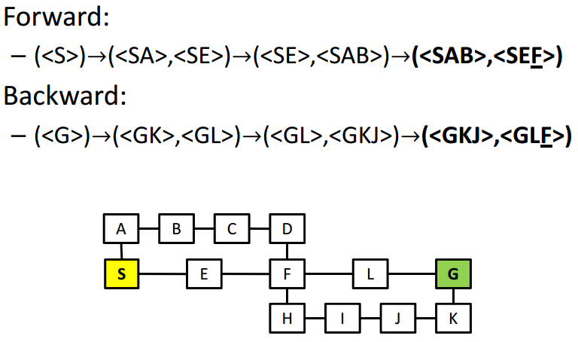
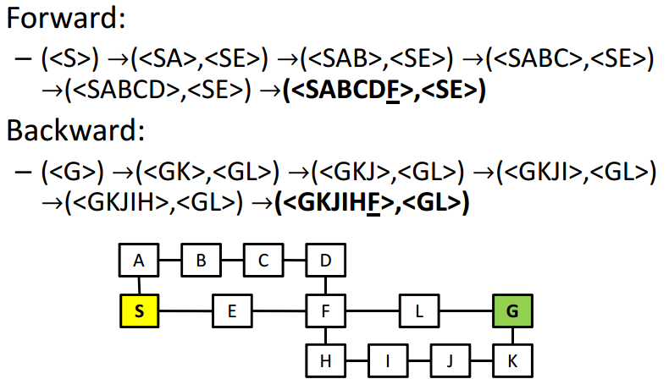
Bidirectional Search
BFS
DFS

Slide 29
Informed Search
Strategy of problem solving where problem specific knowledge is known along with problem definition
These search find solutions more efficiently by the use of heuristics
Heuristic is a search technique that improves the efficiency of the search process
By eliminating the unpromising states and their descendants from consideration, heuristic algorithms can find acceptable solutions

Slide 30
Informed Search
Heuristics are fallible i.e. they are likely to make mistakes as well
It is the approach following an informed guess of next step to be taken
It is often based on experience or intuition
Heuristic have limited information and hence can lead to suboptimal solution or even fail to find any solution at all

Slide 31
Best First Search
A node is selected for expansion based on evaluation function f(n)
A node with lowest evaluation function is expanded first
The measure i.e. evaluation function must incorporate some estimate of the cost of the path from a state to the closest goal state
The algorithm may have different evaluation function, one of such important function is the heuristic function h(n) where, h(n) is the estimated cost of the cheapest path from node n to the goal

Slide 32
Best First Search: Types
Greedy Best First Search
A* Search

Slide 33
Greedy Best First Search
The node whose state is judged to be the closest to the goal state is expanded first
At each step it tries to be as close to the goal as it can
It evaluates the nodes by using heuristic function hence, f(n)=h(n) where, h(n)=0, for the goal node
This search resembles depth first search in the way that it prefers to follow a single path all the way to the goal or if not found till the dead end and returns back up

Slide 34
Greedy Best First Search
Completeness
Can start down an infinite path and never return to any possibilities
Not complete
Optimality
Looks for immediate best choice and doesn’t make careful analysis of long term options
May give longer solution even if shorter solution exists
Not optimal
Space Complexity
O(b^{m}) where, m is the maximum depth of search space, since all nodes have to be kept in memory
Time Complexity
O(b^{m})

Slide 35
A* Search
Evaluates node by combining g(n), the cost to reach the node and h(n) the cost to get from node to goal f(n)=g(n)+h(n) where f(n) is the estimated cost of the cheapest solution through node n
To find the cheapest solution, the first try node is the mode with lowest g(n)+h(n)

Slide 36
A* Search
Admissible Heuristic: h(n) is admissible if it never overestimates cost to reach the solution example: h_{SLD} (straight line distance) as g(n) is exact, so f(n) is never overestimated

Slide 37
A* Search
Optimality
Optimal if h(n) is admissible
Completness
Complete if h(n) is admissible
Space Complexity
O(b^{d}) if h(n) is admissible
Time Complexity
O(b^{d}) if h(n) is admissible

Slide 38
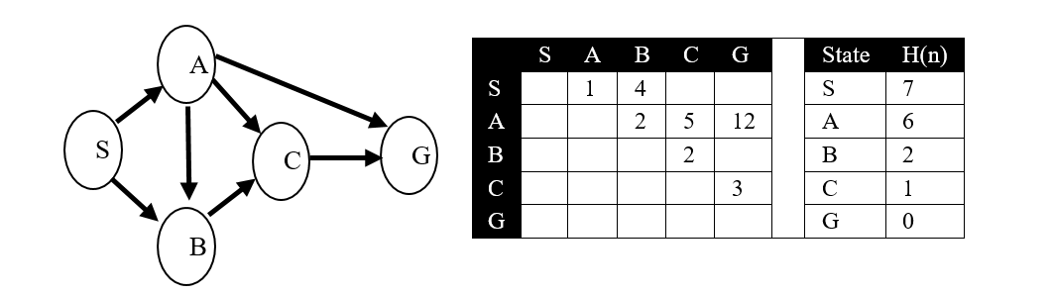
A* Search
Example…

Slide 39
Local Search Algorithm and Optimization
Optimization
Aim to find the best state according to an objective function
Local Search Algorithm
It operates using a single current state rather than multiple path and generally move only to neighbour of that state

Slide 40
Iterative Improvement Algorithm
Consider that all the states are laid down on the surface of a landscape
The height of a point on a landscape corresponds to process to move around the landscape trying to find the highest peaks, which are the optimal solutions
Algorithm is suitable for problems where the path of the goal is irrelevant and only final configuration matters

Slide 41
Iterative Improvement Algorithm
Fig.: A One Dimensional State Space Landscape
Global Maxima
Objective Function
Flat Local Maxima
Shoulder
Current State
Local Maxima
Local Minima
Global Minima
State Space →

Slide 42
Iterative Improvement Algorithm: Types
Hill Climbing Search
Simulated Annealing Search
Local Beam Search
Genetic Algorithm

Slide 43
Hill Climbing Search
Moves continuously in the direction of increasing value (uphill)
Doesn’t maintain a search tree so the current node data structure needs only record the state and its objective function value
Hill climbing doesn’t look ahead beyond the immediate neighbours of the current state
Also called greedy local search sometimes because it grabs a good neighbour state without thinking about where to go next

Slide 44
Hill Climbing Search
it often makes very rapid progress towards the solution because it is usually quite easy to improve a bad state
One move is selected and all other nodes are rejected and are never considered
Halts if there is no successor

Slide 45
Hill Climbing Search: Problems
Local Maxima
Peak that is higher than each of its neighbouring states but lower than the global maxima
Hill climbing halts whenever a local maxima is reached
Plateau
An area of the state space landscape where the evaluation function is flat
Can be flat local maxima where no uphill exists or shoulder from which it is possible to progress
A hill climbing search might be unable to find its way off the plateau
Ridges
A special kind of local maxima which is the result of a sequence of local maxima that is very difficult for greedy algorithms to navigate
It is an area of search space that is higher than the surrounding areas and that itself is at a slope

Slide 46
Hill Climbing Search: Solution to the Problems
Local Maxima
Backtrack to some earlier node and try going to different direction
Plateau
Make a big jump in some direction to try to get a new section of the search space
If rule apply single small steps, apply them several times in the same direction
Ridges
Apply two or more rules such as bidirectional search before doing the test
Moving in several directions at once

Slide 47
Simulated Annealing Search
Rather than starting from a different initial state all over again, when a current state shows no progress in the technique
This search takes some downhill steps so that it can escape that particular local maxima and continue with other peaks in the state space
A random pick is made for the move
If it improves the situation, it is accepted straight away
If it worsen the situation, it is accepted with some probability less than 1 which decreases exponentially with the badness of the move i.e. for bad moves the probability is low and for comparatively less bad one, it’s higher

Slide 48
Simulated Annealing Search
The degree of badness of the move is determined by the amount ∆E, by which the evaluation is worsened
The probability also depends on the value of a objective function parameter ‘T’
For low value of T, probability is high and vice versa
Hence, bad moves are more likely to be allowed at the beginning only
This method is more common in VLSI layout problem solving, factory scheduling and travelling salesman problems

Slide 49
Local Beam Search
A path based algorithm
Keeps track of k-states rather than just one
Begins with k randomly generated states, at each step, all the successors of all k states are generated
If any one is the goal, the algorithm halts
Can quickly become concentrated in a small region of the state space

Slide 50
Genetic Algorithm
A variant of stochastic beam search in which successor states are generated by combining two parent states, rather than by modifying a single state
It begins with a set of k randomly generated states called the population
Each state or individual is represented as a string over a finite alphabet most commons 0s and 1s
Fitness function defines the fitness value of each state

Slide 51
Genetic Algorithm
Cross over point is randomly chosen for crossing of strings, which yields offspring for each generation
Each individual of next generation offspring is subjected to random mutation with a small independent probability
The primary advantage of GA comes from crossover operation
GA combines an uphill tendency with random exploration and exchange of information among parallel search threads
GA has widespread impact on optimization problem such as circuit layout and job scheduling

Slide 52
Genetic Algorithm
Steps in Genetic Algorithm
Represent the problem variable as a chromosome of a fixed length, choose the size of a chromosome population N, the crossover probability pc and the mutation probability pm.
Define a fitness function to measure the fitness of an individual chromosome in the problem domain.
Randomly generate an initial population of chromosomes of size N: x1, x2,.., xN
Calculate the fitness of each individual chromosome: f(x1), f(x2), . . . , f(xN)
Select a pair of chromosomes for mating from the current population based on their fitness.
Create a pair of offspring chromosomes by applying the genetic operators − crossover and mutation.
Place the created offspring chromosomes in the new population.
Repeat Step 5 until the size of the new chromosome population becomes equal to the size of the initial population, N.
Replace the initial (parent) chromosome population with the new (offspring) population.
Go to Step 4, and repeat the process until the termination criterion is satisfied

Slide 53
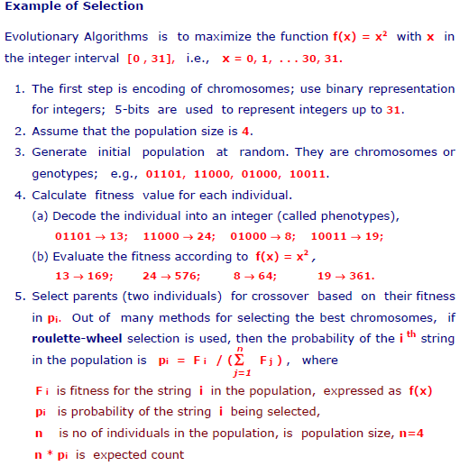
GA : Case Study

Slide 54
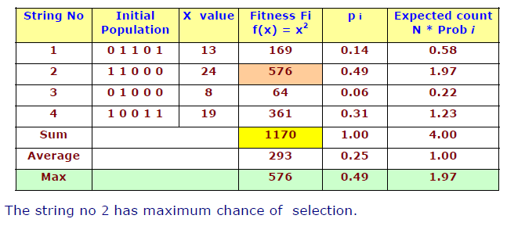
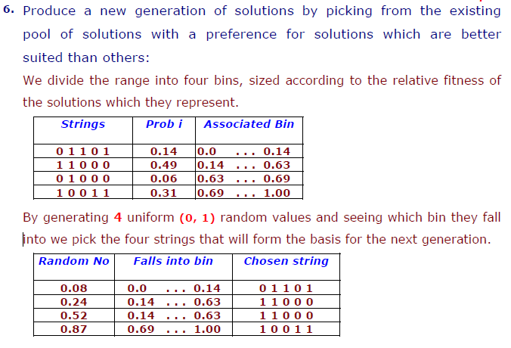
GA : Case Study

Slide 55
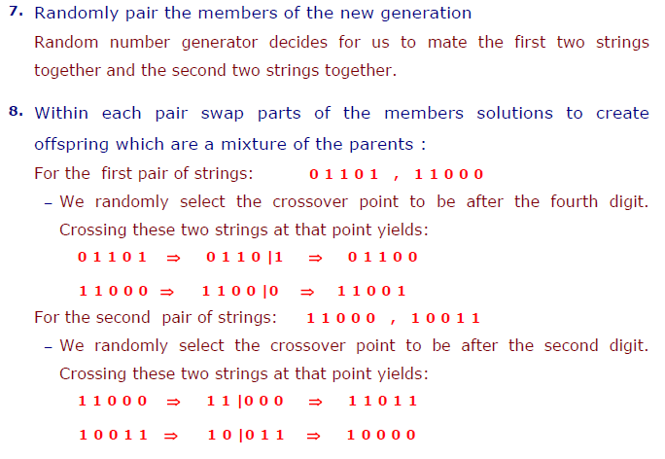
GA : Case Study

Slide 56
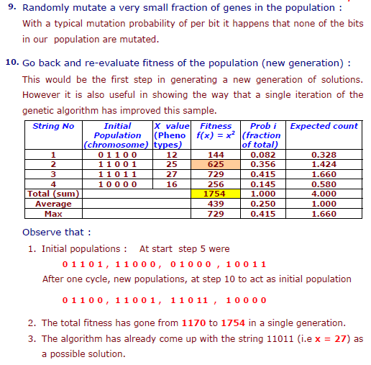
GA : Case Study

Slide 57
Genetic Algorithm
Genetic algorithms are used to solve many large problems including:
-Scheduling
- Transportation
-Chemistry, Chemical Engineering
- Layout and circuit design
-Medicine
-Data Mining and Data Analysis
-Economics and Finance
-Networking and Communication
- Game etc.

Slide 58
Adversarial Search Techniques
Often known as Games or Game Playing
Used in competitive multi-agent environments
Based on game theory
Deterministic and fully observable environments in which there are two agents whose actions must alternate and in which the utility values at the end of the game are always equal and opposite
This creates adversarial situation

Slide 59
Optimal Decision in Adversarial Search
A game can be defined as a kind of search problem with the following components:
Initial State identifying the initial position in the game and identification of the first player
Successor Function returning a list of (move, state) pairs
Terminal Test which determine that the game is over
Utility function which gives a numeric value for the terminal states.

Slide 60
Minimax Algorithm
Max is considered as the first player in the game and Min as the second player
This algorithm computes the minimax decision from the current state
It uses a recursive computation of minimax values of each successor state directly implementing some defined function
The recursion proceeds from the initial node to all the leaf nodes
Then the minimax values are backed up through the tree as the recursion unwinds
It performs the depth first exploration of a game tree in a complete way

Slide 61
Alpha Beta Pruning
Minimax algorithm has to examine exponentially increasing number of moves
As the exponential rise can’t be avoided Pruning cut it into halves
By not considering a large part of the tree number of states to be calculated is cut down
When applied to a standard minimax tree, alpha beta pruning returns the same move as minimax would, but prunes away the branches which couldn’t possibly influence the final decision
Alpha beta pruning could be applied to the trees of any depth

Slide 62
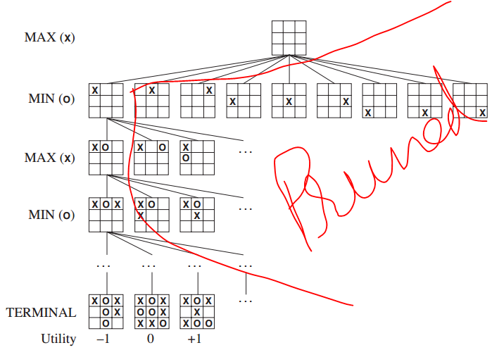
Alpha Beta Pruning

Slide 63
References
Russell, S. and Norvig, P., 2011, Artificial Intelligence: A Modern Approach, Pearson, India.
Rich, E. and Knight, K., 2004, Artificial Intelligence, Tata McGraw hill, India.

Slide 64
Thank You
Any Queries?
Now, Search for yourself.

